Slide 1



Journal of Marketing 2018
Selling the Premium in Freemium
—Xian Gu, P.K. Kannan and Liye Ma
第五組
鄭心愉 111423020
柳成彥 111423027
陳玟靜 111423031
陳映彤 111423038
陳佳辰 111423058
李昕瑩 111423063
蔣銘皓 111423009

Slide 2
01
研究背景
動機與目的

Slide 3
Abstract
陳映彤
The success of a freemium model depends on the number of customers who purchase the premium version in the presence of the free version.
Extending the premium product line to spur demand for the existing premium version
Notes:
首先，我們先簡單摘要一下這個論文
其實這個論文要探討的問題很清楚，就是剛剛標題所說的:怎麼樣能夠在freemium的商業模式下，賣出更多的premium版本，賺到更多錢呢?
對於這個問題，作者提出了一個策略，就是擴展現有的產品線。透過推出更高階或者更低階的版本，引導使用者去購買原本就有的premium版本，來增加銷量

Slide 4
Abstract
陳映彤
The authors conduct a randomized field experiment with an online content provider that offers book titles in a PDF version for free and sells the paperback version for a premium.
Add hardcover and e-book version
Notes:
為了驗證這個策略是否可行，作者與一家出版商合作，進行了一場實驗，原本這個出版業者的書，都有推出需要付費購買的平裝版本，還有畫質比較低但是免費的pdf版本。
作者就在這個基礎上，推出了精裝書還有電子書，這兩種新版本。

Slide 5
Abstract
陳映彤
The authors show that paperback titles accompanied by an additional premium version
Compromise effect and attraction effect
A significant contribution not only in the freemium context but also to the product line literature
Notes:
最後結果證明了，這兩種產品的推出，反而刺激了現有的平裝版本的銷量。
對於這種現象，作者提出了妥協效果(compromise effect)跟吸引力效果(attraction effect)這兩個解釋。
而這個實驗，對freemium這商業模式還有產品線的相關文獻提供了很好的證據跟驗證
這就是這篇論文大概的摘要，接下來我們會再進行更詳細的說明

Slide 6


Background
陳映彤
Freemium = Free + Premium
Refers to the strategy in which customers can get a basic version of a product or service for free and switch to a premium version with additional features by paying a price.
Notes:
關於這篇論文的背景，其實就圍繞在我剛剛一直提到的freemium這個商業模式之中。
freemium這個字是free還是premium這兩個字組合再一起形成的，是指使用者可以免費使用產品，然後付費解鎖更高級的服務或者更多的功能的一種商業模式，而這種模式的成功，就取決於願意付費的人有多少
現在很多公司都是採用freemium這個商業模式，像是dropbox或者youtube premium

Slide 7
Motivation
陳映彤
How to increase the number of customers who purchase the premium version in the presence of the free version.
If a company is unable to convert an adequate fraction of its free customers to paying customers, the freemium model is likely to fail.
Notes:
在這樣的背景下，使用免費增值模式的公司面臨的一個關鍵挑戰是如何在免費版本存在的情況下增加購買付費版本的客戶數量。如果一家公司無法將足夠多的免費客戶轉化為付費客戶，那麼免費增值模式很可能會失敗

Slide 8
Motivation
陳映彤
Extant research has not studied the premium product line that many implementations of the freemium model involve.
Understanding the impact of such line extensions can be critical for the success of the freemium model.
Notes:
現有的研究沒有研究免費增值模式的許多實施所涉及的高級產品線（例如，Dropbox 為個人消費者提供高級版本，為企業提供高級版本）。
了解此類產品線擴展的影響對於免費增值模式的成功至關重要。

Slide 9
Research Purpose
陳映彤
Focus on the impact of extending the product line to spur demand for the existing premium version and to increase overall revenues
Requires a closer examination of the demand outcomes driven by the potential effects of different behavioral mechanisms
Notes:
在這項研究中，我們關注擴展產品線 以刺激對現有高級版本的需求 並增加整體收入的影響。
免費增值模式中免費版本的出現帶來了概念上的細微差別，這不僅需要在此背景下應用標準產品線模型，還需要更仔細地檢查由不同行為機制的潜在影響驅動的需求結果。 這是本文的主要目標之一。

Slide 10
02
重要的文獻探討

Slide 11
Product Line Extension
陳佳辰
Higher-price , Higher-quality:
the introduction of higher-quality, higher-priced alternatives in the line can lead to increases in brand evaluations of freemium brand , making entire product line more attractive
(Variety Effect & Quality Association Effect)
(2) Lower-price , Lower-quality:
the introduction of lower-quality, lower-priced alternatives in the product line can lead to cannibalization and decreased revenue and profits
The net impact of these effects depends on the magnitude of these effects.
Revenues may increase/decline when the other positive/negative impacts generated.

Slide 12
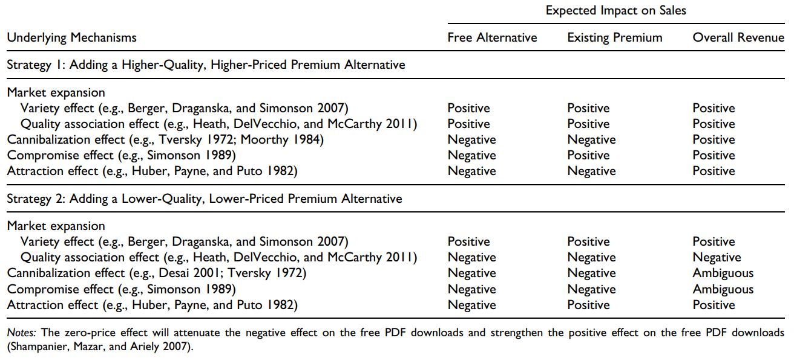
Nuances in the Freemium Context
陳佳辰

Slide 13
03
研究方法

Slide 14
Field Experiment
鄭心愉
Institutional Setting
(1) National Academies Press (NAP) is a nonprofit publisher of scholarly content and self-sufficient. Most of sales revenue comes from its website.
(2) Changed its business model to a freemium model, wherein the PDF version of any book title could be downloaded for free, while a paperback version of the title could be purchased online for a price.
(3) Add a hardcover version with superior production quality and a more durable cover and binding.
(4) Add an e-book version, with resolution quality somewhat similar to the PDF version.
Notes:
接下來要介紹研究方法
首先是機構的背景
1.國家科學院出版社是一個美國的非營利學術機構，他的經營模式是自給自足，大部分的收入來源是網站。
2.近期他的也從商業模式改爲免費模式，其中PDF版本的書籍都可以免費下載，而平裝版的書也可以在網上購買。
(“免費增值”一詞是“免費”和“高階”的組合，指的是客戶可以透過支付價格免費獲得產品或服務的基本版本，並切換到具有額外功能的高階版本的策略。)
3.增加了精裝版本，具有較高的生產品質和耐用的封面和裝訂。
4.增加了電子書版本，是比ＰＤＦ有更高的畫質。

Slide 15

Field Experiment
鄭心愉
(5) Research the impact of extending the product line of premium products on the revenues of NAP.
(6) The free and premium versions will differ only in their formats and prices.
(7) NAP is a monopolist in the market for its specialized and authoritative content because it has the exclusive right to publish studies of the National Academies.
Notes:
5.主要也是要研究擴展產品線如何達到增加ＮＡＰ收入。
6.免費版和付費版本只有價格上的差別，書籍內容是都一樣的。
7.NAP 市場上的壟斷者，因為它擁有出版國家科學院研究報告的專利。
這使這個研究擺脫了潛在遺漏變數問題。 這兩個特徵有助於確保一個乾淨的實驗環境，從而提高研究結果的有效性。

Slide 16
Field Experiment
鄭心愉
Formats in the Product Line
E-book
Hardcover
Can resize fonts, bookmark pages, make notes, highlight specific passages, and save selected text. | Higher-quality, higher-priced and more durable than the paperback version.
Image resolution lower than that of the existing premium version. | Can be leafed through quickly and stacked on a bookshelf for easy retrieval.
PDF
Paperback
Notes:
Ebook 可以調整字體大小，書籤頁面，做筆記，突出顯示特定的段落，並保存選定的文本。
Hardcover 比平裝本質量更高，價格更高，更耐用。
PDF 解析度低於現有高級版本。
Paperback 可以快速翻頁，並堆放在書架上方便檢索。

Slide 17
Field Experiment
蔣銘皓
Experimental Design
The field experiment includes a total of 2,051 randomly selected book titles that NAP was already selling in paperback on its website before the start of the experiment.
(1) Randomized block design:
Use a restricted randomized design that uses the price of the paperback version as one blocking variable with three levels (low, medium, and high) and title popularity as the other blocking variable with three levels (low, medium, and high).

Slide 18
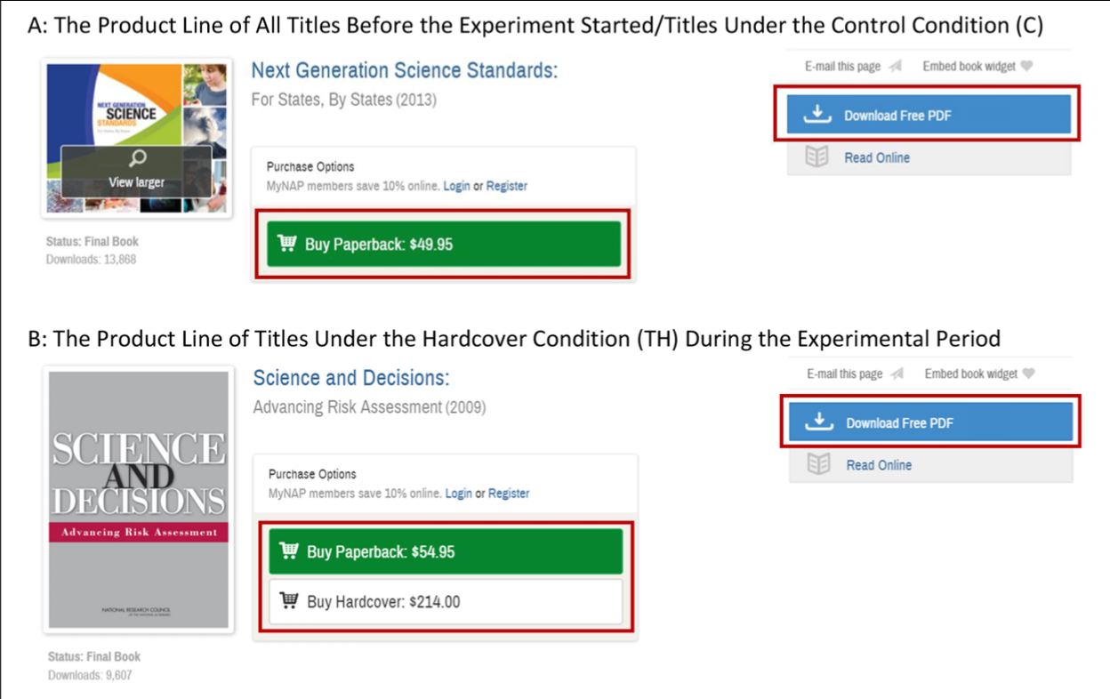
Field Experiment
蔣銘皓
(2) Control and treatment conditions:

Slide 19
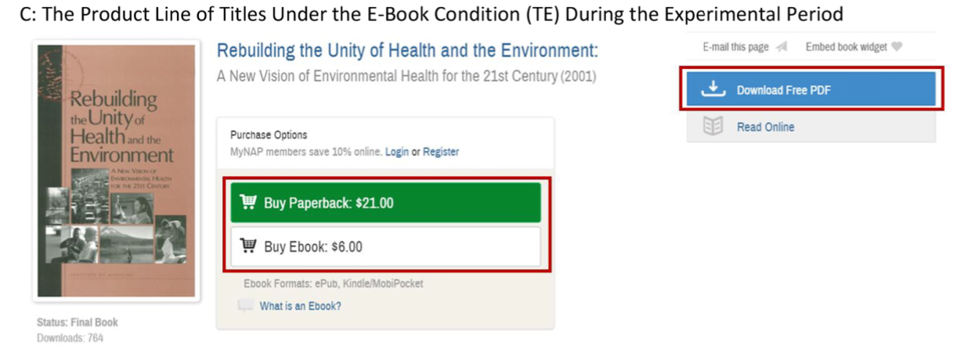
Field Experiment
蔣銘皓
(2) Control and treatment conditions:

Slide 20
Field Experiment
蔣銘皓
(3) Price of the new premium versions:
Paperback versions were kept at their existing levels of price.
PDF versions being available for free.
E-book versions were priced lower than the price of paperback versions.
Hardcover versions were set between the range of 160% and 790% of the paperback version prices.

Slide 21
Field Experiment
蔣銘皓
Descriptive Statistics
Data set:
(1) Price of different versions
(2) Copyright Year
(3) Number of Pages
Observation:
(1) sale quantities and revenues in three conditions
(2) number of free PDF downloads
(3) number of email campaigns

Slide 22
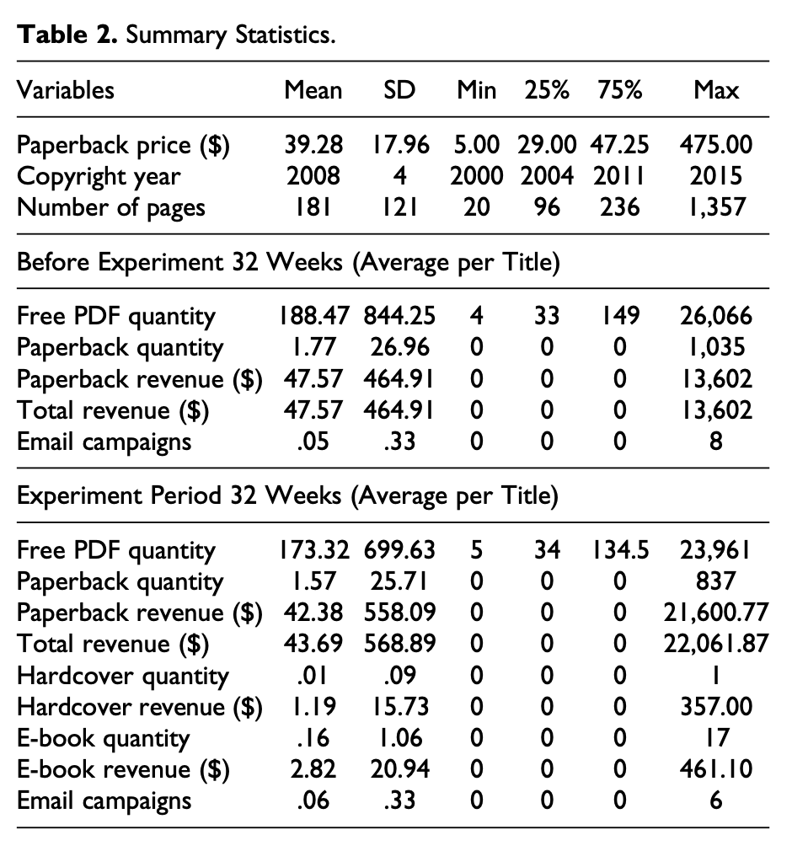
Field Experiment
蔣銘皓
Descriptive Statistics
Table 2 : Summary Statistics
Positive download of free PDF,
but decreased during experiment
(Due to season effects)
Hardcover: 1.19$ / per book
E-book: 2.82$ / perbook

Slide 23
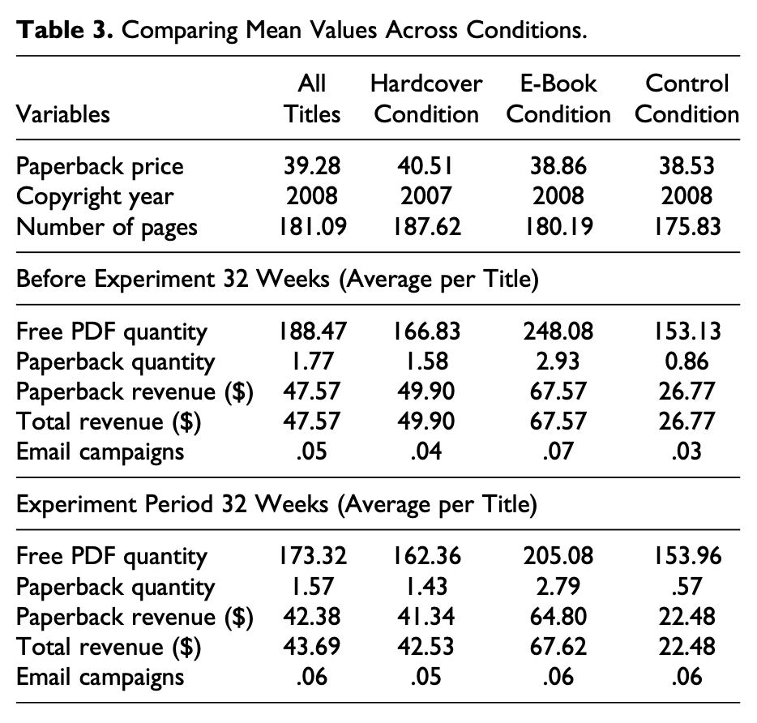
Field Experiment
蔣銘皓
Descriptive Statistics
Table 3 : Comparing Mean Values
Paperback version decreased
in all three conditions
slightly increase of
E-book total revenues
Adding new version may lead to fewer
downloads of free PDF version

Slide 24
04
資料分析

Slide 25
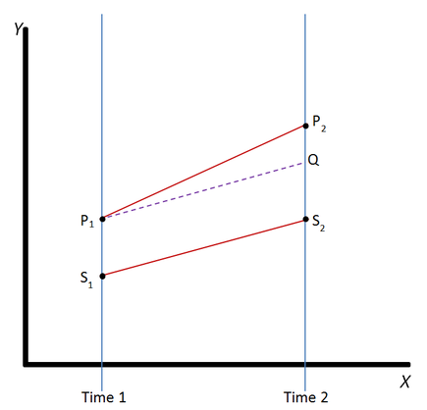
DID(Difference-in-Differences) Model
柳成彥
Difference in differences requires data measured from a treatment group and a control group at two or more different time periods, specifically at least one time period before "treatment" and at least one time period after "treatment."

Slide 26
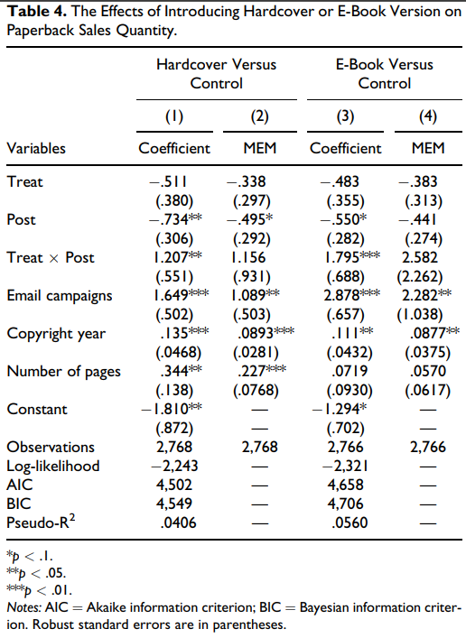
Main Results - Hardcover Version
柳成彥
Introducing the hardcover version increases demand for the paperback version.
Using email campaigns increased paperback sales.
Book titles that were published more recently and with more pages had higher paperback sales

Slide 27
Main Results - E-book Version
柳成彥
Introducing the e-book version increases demand for the paperback version.
Using email campaigns increased paperback sales.
Book titles that were published more recently had higher paperback sales.

Slide 28
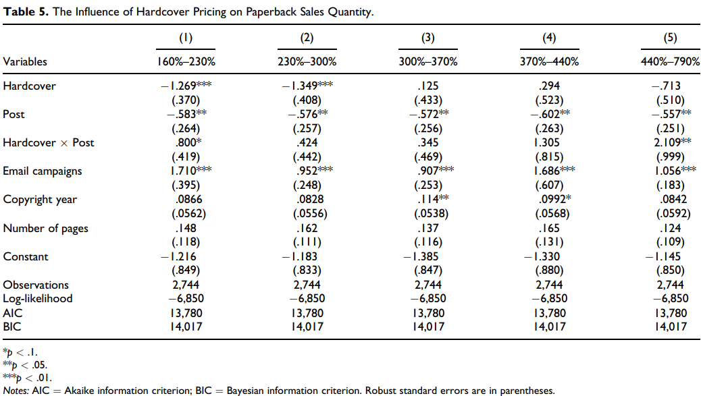
Price of New Premium Versions
柳成彥

Slide 29
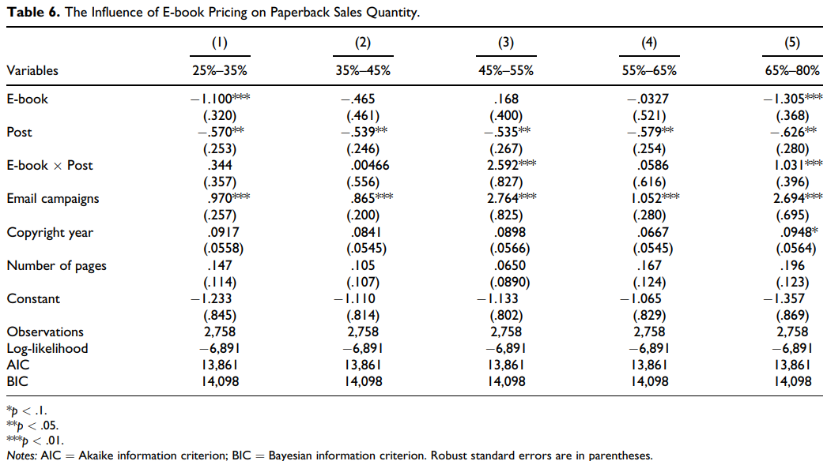
Price of New Premium Versions
柳成彥

Slide 30
Underlying Mechanisms on Hardcover Version
陳玟靜
 | PDF | Paperback | Hardcover
Quality | 1 | 2 | 3
Mean ratings | 6.11 | 7.81
The compromise effect predicts that adding the hardcover version will increase the choice probability of the paperback version.

Slide 31
Underlying Mechanisms on E-book Version
陳玟靜
 | PDF | E-book | Paperback
Quality | 1 | 1.111 | 3
Too Close
If an e-book is priced too closely to its paperback counterpart, consumers may find the e-book price “unfairly high”, this generates the attraction effect.
When an e-book is introduced with a relatively high price, then, the sales of the paperback version can increase because of this attraction effect.

Slide 32
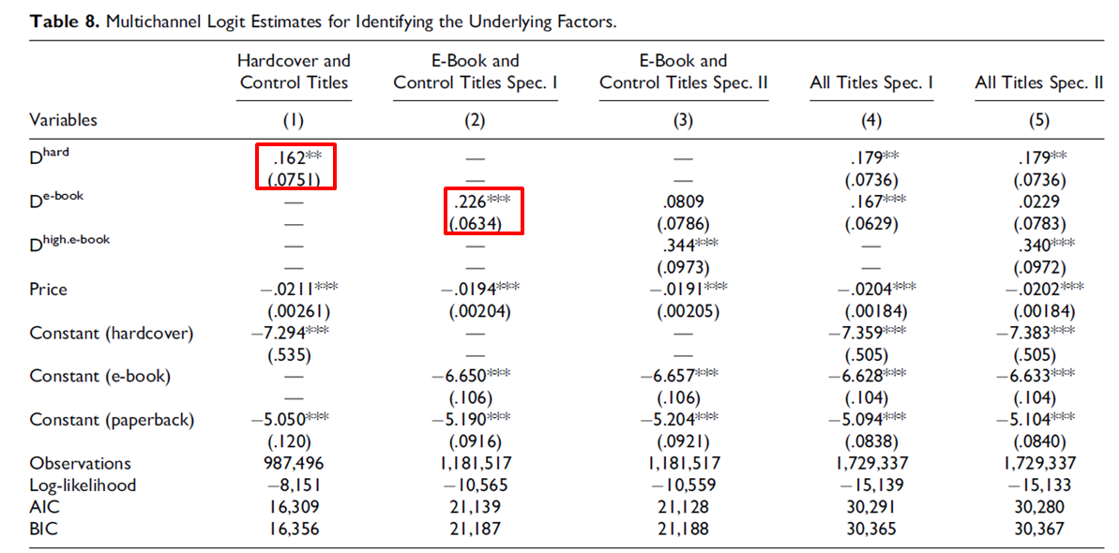
Estimation Results- Compromise Effects
陳玟靜

Slide 33
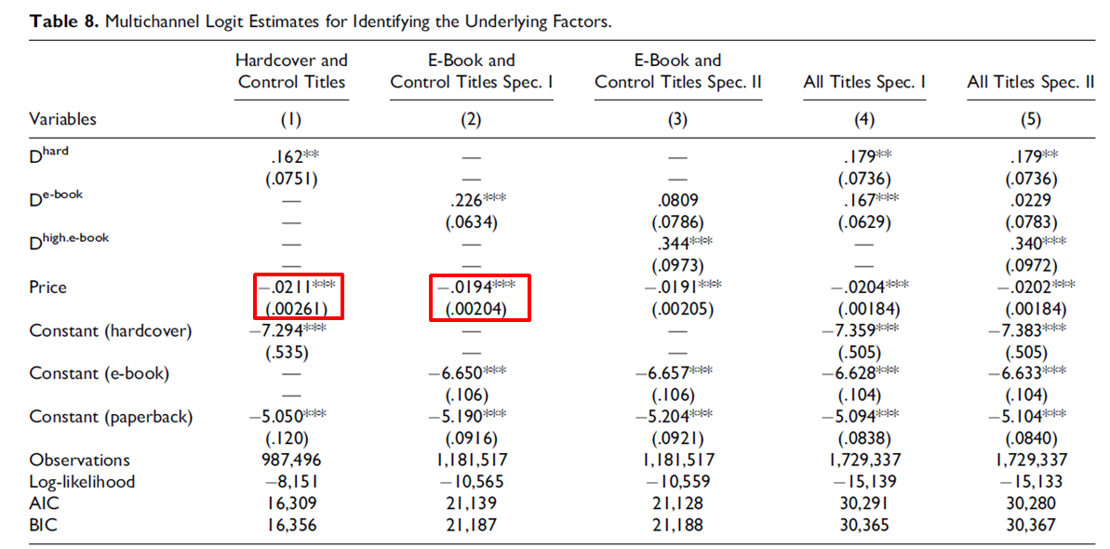
Estimation Results- Price
陳玟靜

Slide 34
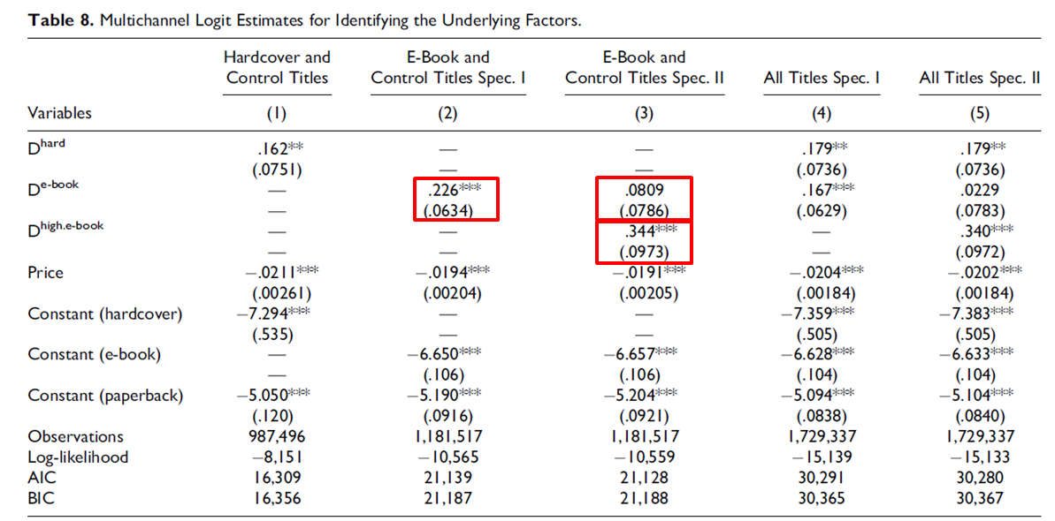
Estimation Results-Attraction Effects
陳玟靜

Slide 35
05
建議&結論

Slide 36
Suggestions
李昕瑩
the findings should extend to other freemium implementations
eg. streaming video or audio services, such as YouTube
adding another premium version and differentiating the two versions in terms of resolution or speed
Firms could differentiate the quality of the premium versions and the free version on the basis of the availability of different functions and features.

Slide 37
Conclusions
李昕瑩
This paper :
shows how firms can increase their sales in the freemium models.
uncover possible behavioral mechanisms that contribute to such increases.
highlights the role of the behavioral mechanisms as alternative explanations for the demand patterns observed in the field experiment.

Slide 38
06
工作分配

Slide 39
研究背景與動機-陳映彤
重要的文獻探討-陳佳辰
研究方法-鄭心愉/蔣銘皓
資料分析&結果-陳玟靜/柳成彥
結論&建議-李昕瑩

Slide 40
Thanks!
Does anyone have any questions?

